Slide 1


L1 : Module 4
Presented By- Keshav Jha
Role- Associate Software Engineer Trainee

Slide 2
Table Of Content
Task 1
Task 2
What Technical Debt Is And How It's Measured ?
Graph algorithm Implementation
How to Automate Business Processes ?

Slide 3
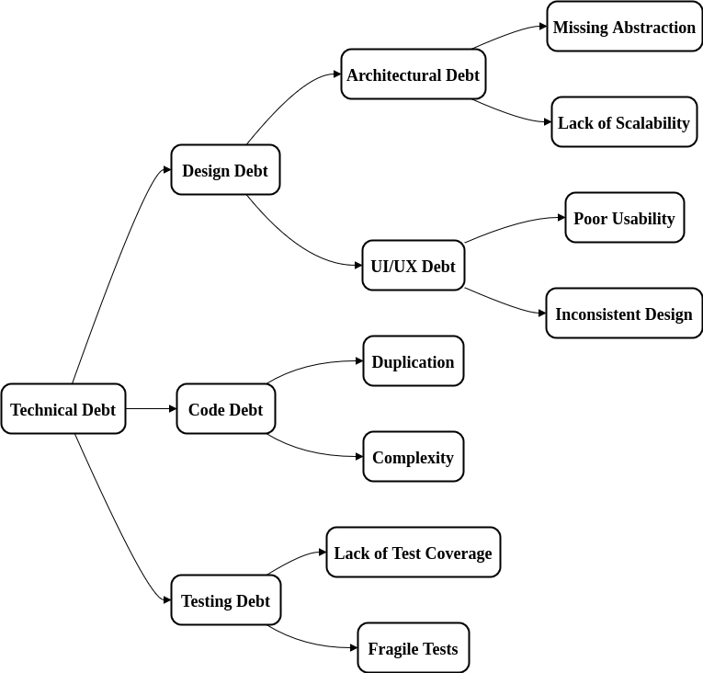
What Technical Debt Is And How It's Measured ?
Technical debt refers to the long-term consequences of suboptimal technical decisions made during software development. It's like taking shortcuts to meet deadlines, which might save time in the short term but can lead to more work and complexity in the long run. Just like financial debt, technical debt accrues "interest" in the form of increased maintenance costs, reduced efficiency, and slower progress.
Types of Technical Debt​
​
Design Debt​
Coding Debt​
Testing Debt
1. Design Debt​
This happens when the architecture or design of the software is not optimal. It might be due to rushing to get a product out quickly or lacking the foresight to create a scalable and maintainable design. Over time, design debt can make the system harder to understand and modify.​
2. Coding Debt​
Coding debt is when the code itself is messy, poorly written, or lacks proper structure. This can occur due to hasty coding, lack of adherence to coding standards, or simply inexperience. Messy code can lead to bugs, make the codebase difficult to understand, and slow down development.​
3. Testing Debt​
Testing debt arises when there aren't enough automated tests, or the existing tests are of poor quality. Skipping tests or not maintaining them properly can lead to undetected bugs and make it hard to ensure that new changes don't break existing functionality.​

Slide 4
What Technical Debt Is And How It's Measured ?
Measuring Technical Debt
There isn't a one-size-fits-all metric for technical debt, but here are some common methods:
Code Quality Metrics:
Cyclomatic Complexity: Measures the complexity of code.
Code Smells: Indicators of potential issues in the code.
Coverage: Percentage of code covered by automated tests.
Cost to Fix: Estimating the time and resources needed to address the debt.
Interest: Evaluating the ongoing impact of the debt, such as time spent on workarounds or dealing with bugs.
Principal: The effort required to completely repay the debt, i.e., refactoring code or redesigning architecture.
Tools:
SonarQube: For code quality analysis.
Code Climate: For automated code review.
Technical Debt Ratio (TDR): Ratio of remediation cost to development cost.

Slide 5
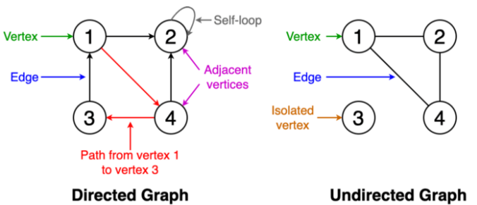
Graph algorithm Implementation
What is a Graph?
A graph is a unique data structure in programming that consists of finite sets of nodes or vertices and a set of edges that connect these vertices to them. At this moment, adjacent vertices can be called those vertices that are connected to the same edge with each other. In simple terms, a graph is a visual representation of vertices and edges sharing some connection or relationship. Although there are plenty of graph algorithms that you might have been familiar with, only some of them are put to use. The reason for this is simple as the standard graph algorithms are designed in such a way to solve millions of problems with just a few lines of logically coded technique. To some extent, one perfect algorithm is solely optimized to achieve such efficient results.
Types of Graphs:
Weighted graph: A graph having value or weight of vertices.
Unweighted graph: A graph having no weight of vertices.
Directed graph: A graph having a direction indicator.
Undirected graph: A graph where no directions are defined.
A graph in data structure is made up of two primary components:
Vertices (or Nodes):
These are the entities or points in the graph. They can represent various things depending on the context, such as cities in a map, people in a social network, or computers in a network.
Edges (or Arcs):These are the connections between the vertices. Edges can be directed (one-way) or undirected (two-way). Directed edges are like one-way streets, while undirected edges are like two-way streets. Edges can also have weights, which represent the cost or distance between the vertices.

Slide 6
Graph algorithm Implementation
Breadth-first search(BFS)
BFS is a graph traversal algorithm that starts traversing the graph from the root node and explores all the neighboring nodes. Then, it selects the nearest node and explores all the unexplored nodes. While using BFS for traversal, any node in the graph can be considered as the root node.
BFS puts every vertex of the graph into two categories - visited and non-visited. It selects a single node in a graph and, after that, visits all the nodes adjacent to the selected node.
Applications of BFS algorithm
BFS can be used to find the neighboring locations from a given source location.
In a peer-to-peer network, BFS algorithm can be used as a traversal method to find all the neighboring nodes. Most torrent clients, such as BitTorrent, uTorrent, etc. employ this process to find "seeds" and "peers" in the network.
BFS can be used in web crawlers to create web page indexes. It is one of the main algorithms that can be used to index web pages. It starts traversing from the source page and follows the links associated with the page. Here, every web page is considered as a node in the graph.
BFS is used to determine the shortest path and minimum spanning tree.
Algorithm:
Step 1: SET STATUS = 1 (ready state) for each node in G
Step 2: Enqueue the starting node A and set its STATUS = 2 (waiting state)
Step 3: Repeat Steps 4 and 5 until QUEUE is empty
Step 4: Dequeue a node N. Process it and set its STATUS = 3 (processed state).
Step 5: Enqueue all the neighbours of N that are in the ready state (whose STATUS = 1) and set
their STATUS = 2
(waiting state)
[END OF LOOP]
Step 6: EXIT

Slide 7
Graph algorithm Implementation
Depth First Search algorithm
The depth-first search (DFS) algorithm starts with the initial node of graph G and goes deeper until we find the goal node or the node with no children.
Because of the recursive nature, stack data structure can be used to implement the DFS algorithm. The process of implementing the DFS is similar to the BFS algorithm.
The step by step process to implement the DFS traversal is given as follows -
First, create a stack with the total number of vertices in the graph.
Now, choose any vertex as the starting point of traversal, and push that vertex into the stack.
After that, push a non-visited vertex (adjacent to the vertex on the top of the stack) to the top of the stack.
Now, repeat steps 3 and 4 until no vertices are left to visit from the vertex on the stack's top.
If no vertex is left, go back and pop a vertex from the stack.
Repeat steps 2, 3, and 4 until the stack is empty.
Applications of DFS algorithm
DFS algorithm can be used to implement the topological sorting.
It can be used to find the paths between two vertices.
It can also be used to detect cycles in the graph.
Algorithm
Step 1: SET STATUS = 1 (ready state) for each node in G
Step 2: Push the starting node A on the stack and set its STATUS = 2 (waiting state)
Step 3: Repeat Steps 4 and 5 until STACK is empty
Step 4: Pop the top node N. Process it and set its STATUS = 3 (processed state)
Step 5: Push on the stack all the neighbors of N that are in the ready state (whose STATUS = 1) and set their STATUS = 2 (waiting state)
[END OF LOOP]
Step 6: EXIT

Slide 8
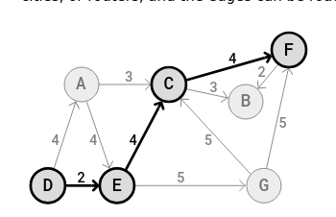
Graph algorithm Implementation
Shortest Path Problem
To solve the shortest path problem means to find the shortest possible route or path between two vertices (or nodes) in a Graph.
In the shortest path problem, a Graph can represent anything from a road network to a communication network, where the vertices can be intersections, cities, or routers, and the edges can be roads, flight paths, or data links.
The shortest path from vertex D to vertex F in the Graph above is D->E->C->F, with a total path weight of 2+4+4=10. Other paths from D to F are also possible, but they have a higher total weight, so they can not be considered to be the shortest path.
To solve the shortest path problem means to check the edges inside the Graph until we find a path where we can move from one vertex to another using the lowest possible combined weight along the edges.
This sum of weights along the edges that make up a path is called a path cost or a path weight.
Algorithms that find the shortest paths, like Dijkstra's algorithm or the Bellman-Ford algorithm, find the shortest paths from one start vertex to all other vertices.

Slide 9
Graph algorithm Implementation
Dijkstra's Algorithm
Dijkstra's algorithm finds the shortest path from one vertex to all other vertices.
It does so by repeatedly selecting the nearest unvisited vertex and calculating the distance to all the unvisited neighboring vertices.
Dijkstra's algorithm is often considered to be the most straightforward algorithm for solving the shortest path problem.
Dijkstra's algorithm is used for solving single-source shortest path problems for directed or undirected paths. Single-source means that one vertex is chosen to be the start, and the algorithm will find the shortest path from that vertex to all other vertices.
Dijkstra's algorithm does not work for graphs with negative edges. For graphs with negative edges, the Bellman-Ford algorithm that is described on the next page, can be used instead.
To find the shortest path, Dijkstra's algorithm needs to know which vertex is the source, it needs a way to mark vertices as visited, and it needs an overview of the current shortest distance to each vertex as it works its way through the graph, updating these distances when a shorter distance is found.
working:
Set initial distances for all vertices: 0 for the source vertex, and infinity for all the other.
Choose the unvisited vertex with the shortest distance from the start to be the current vertex. So the algorithm will always start with the source as the current vertex.
For each of the current vertex's unvisited neighbor vertices, calculate the distance from the source and update the distance if the new, calculated, distance is lower.
We are now done with the current vertex, so we mark it as visited. A visited vertex is not checked again.
Go back to step 2 to choose a new current vertex, and keep repeating these steps until all vertices are visited.
In the end we are left with the shortest path from the source vertex to every other vertex in the graph.

Slide 10
Graph algorithm Implementation
Prim's Algorithm
Prim's algorithm was invented in 1930 by the Czech mathematician Vojtěch Jarník.
The algorithm was then rediscovered by Robert C. Prim in 1957, and also rediscovered by Edsger W. Dijkstra in 1959. Therefore, the algorithm is also sometimes called "Jarník's algorithm", or the "Prim-Jarník algorithm".
Prim's algorithm finds the Minimum Spanning Tree (MST) in a connected and undirected graph.
The MST found by Prim's algorithm is the collection of edges in a graph, that connects all vertices, with a minimum sum of edge weights.
Prim's algorithm finds the MST by first including a random vertex to the MST. The algorithm then finds the vertex with the lowest edge weight from the current MST, and includes that to the MST. Prim's algorithm keeps doing this until all nodes are included in the MST.
Prim's algorithm is greedy, and has a straightforward way to create a minimum spanning tree.
For Prim's algorithm to work, all the nodes must be connected. To find the MST's in an unconnected graph, Kruskal's algorithm can be used instead.
Working:
Choose a random vertex as the starting point, and include it as the first vertex in the MST.
Compare the edges going out from the MST. Choose the edge with the lowest weight that connects a vertex among the MST vertices to a vertex outside the MST.
Add that edge and vertex to the MST.
Keep doing step 2 and 3 until all vertices belong to the MST.

Slide 11
How to Automate Business Processes ?
To automate business processes, first identify repetitive tasks suitable for automation. Choose the right tools, like Robotic Process Automation (RPA) or Business Process Management (BPM) software. Map out the process, then design and implement the automation workflow. Test to ensure it works correctly, then monitor and optimize for continuous improvement. Train employees on using the new system and troubleshoot any issues that arise. This streamlines operations, reduces errors, and boosts efficiency, allowing your team to focus on more strategic tasks.
1- Identify Repetitive Tasks:
Action: Analyze and list tasks that are performed frequently and are repetitive in nature.
Examples: Data entry, invoice processing, report generation, email responses.
Objective: To pinpoint tasks that, if automated, can save time and reduce human error.
2- Choose Automation Tool:
Action: Research and select the appropriate automation tool that fits your business needs.
Examples:
RPA Tools: UiPath, Automation Anywhere, Blue Prism.
BPM Tools: IBM BPM, Appian, Pega.
Workflow Automation: Zapier, Microsoft Power Automate, IFTTT.
Objective: To select a tool that is capable of automating the identified tasks efficiently and within budget.

Slide 12
How to Automate Business Processes ?
3- Analyze Process:
Action: Conduct a thorough analysis of the process to understand its workflow, dependencies, and bottlenecks.
Steps:
Map out each step of the process.
Identify inputs, outputs, and any decision points.
Evaluate the time taken for each step.
Objective: To determine whether the process can be effectively automated and what improvements can be made.
4- Implement Automation:
Action: Use the selected automation tool to set up the automation workflow.
Steps:
Configure triggers (events that start the automation).
Define actions (tasks performed by the automation).
Set up decision points (conditional logic within the workflow).
Objective: To automate the process according to the analysis and ensure it functions correctly.
5- Reassess Process:
Action: If automation is not feasible, go back and reassess the process.
Steps:
Identify reasons why automation is not feasible.
Consider alternative improvements or simplifications.
Objective: To ensure that the process is optimized even if full automation is not possible.
6- Success?
Action: Evaluate the success of the implemented automation.
Criteria:
Are the tasks being performed accurately?
Is the automation saving time and reducing errors?

Slide 13
How to Automate Business Processes ?
7- Monitor Automation:
Action: Continuously observe the automated process to ensure it remains effective.
Tools: Dashboards, reports, monitoring tools provided by the automation software.
Objective: To catch and address any issues early and to ensure the automation continues to deliver the desired benefits.
8- Troubleshoot Issues:
Action: Identify and resolve any problems that arise with the automation.
Steps:
Analyze the root cause of issues.
Implement fixes or adjustments to the automation.
Test to ensure issues are resolved.
Objective: To maintain the effectiveness of the automated process.
9- Continuously Improve:
Action: Regularly review the automated process and make improvements.
Steps:
Gather feedback from users.
Analyze performance data.
Update the automation to incorporate new requirements or improvements.
Objective: To enhance the process continually, keeping it aligned with business goals and adapting to changes.

Slide 14
Thank You!!

